Slide 1
Flux-anomaly-forced
model intercomparison project (FAFMIP)
Steering committee:
Jonathan Gregory (U Reading and Met Office), Stephen Griffies (GFDL), Detlef Stammer (U Hamburg), Oleg Saenko (CCCma), Johann Jungclaus (MPI)
The goal is to account for the spread in simulated ocean response to changes in surface fluxes resulting from CO₂ forcing. This is an aspect of the CMIP6 science question on the Earth system response to forcing.
Specific interests are
The model spread in geographical patterns of predicted sea level change due to ocean circulation and density change (GC on regional sea level rise).
The global ocean heat uptake efficiency, which affects global mean sea level rise due to thermal expansion (GC on regional sea level rise) and the TCR.
The magnitude of change in the AMOC, which affects regional climate (GC on regional climate information).
The ocean’s role in determining patterns of SST change (GC on climate sensitivity) and ocean temperature change near to ice-shelves (GCs on regional sea level rise and changes in cryosphere).

Slide 2
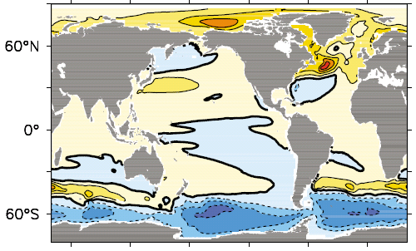
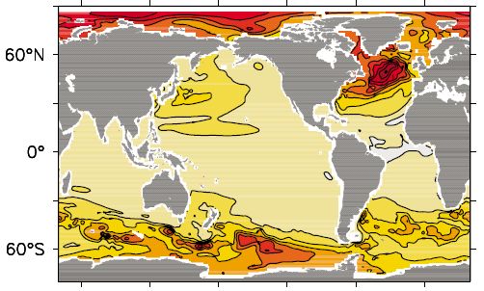


Ocean-dynamical effect on regional sea level change
(relative to global mean sea level rise)
CMIP5 and earlier models show a large diversity in the patterns of predicted sea level change due to ocean circulation and density change. FAFMIP will study the part of the spread due to the ocean’s response to changes in surface forcing.
Model mean
Standard deviation
CMIP5 models under RCP4.5 at 2100
Yin (2012)

Slide 3
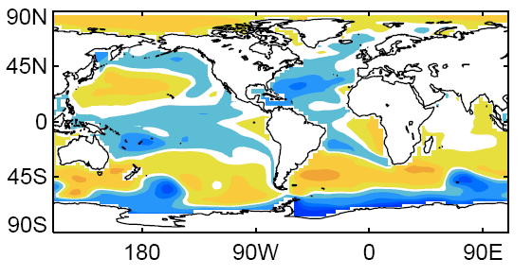
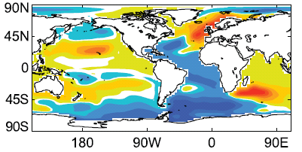

Effect of separated surface flux changes on ocean
In previous work a single AOGCM has been subjected to surface flux changes from a each of a range of CMIP3 AOGCMs, showing that part of the spread in regional sea level rise comes from the forcing fluxes.
Sea level change (wrt global mean) in FAMOUS AOGCM forced by CMIP5
surface momentum flux change
surface heat flux change
m (Bouttes and Gregory, 2014)
FAFMIP will do the converse, by applying the same surface flux changes to various AOGCMs. The influences of CO₂-forced changes in momentum, heat and freshwater fluxes will be distinguished, which has not been done before in most AOGCMs. FAFMIP is an ocean analogue of the CFMIP patterned-SST-change experiment.

Slide 4
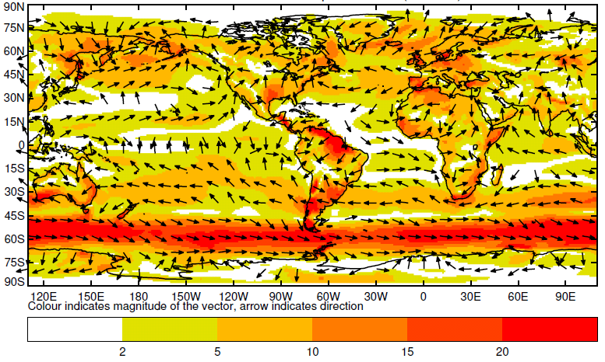
FAFMIP surface momentum flux perturbation (10⁻³ Pa)

Slide 5
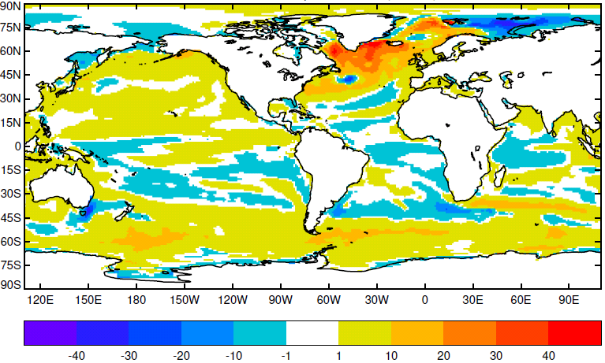
FAFMIP surface heat flux perturbation (W m⁻²)

Slide 6
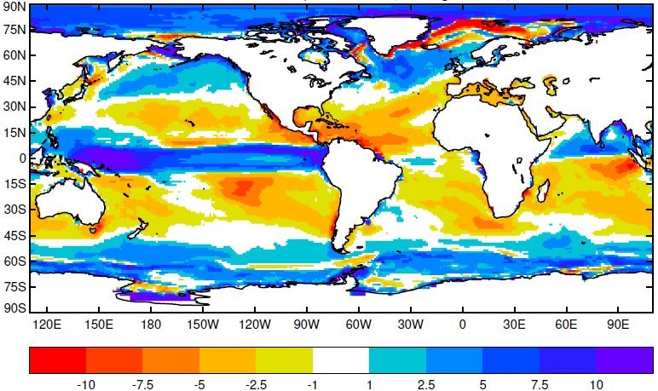
FAFMIP surface freshwater flux perturbation (10⁻⁶ kg m⁻² s⁻¹)

Slide 7
FAFMIP experiments
All are idealised. They all have piControl atmospheric composition (1xCO2) and are parallel to piControl. The AOGCM has surface fluxes applied to the ocean in addition to those computed interactively by the atmosphere, technically like the old technique of flux adjustment. The prescribed additional surface fluxes are functions of longitude, latitude and time of year, obtained fromCMIP5 model-mean changes in surface fluxes at the time of 2xCO2 (year 70) in 1pctCO2, and constant throughout the FAFMIP experiments, which are all 70 years long.
Tier 1:
faf-stress: add perturbation to surface momentum flux (windstress, tau[uv])
faf-heat: add perturbation to surface heat flux into ocean water (hfds)
faf-water: add perturbation to surface freshwater flux into ocean water (wfo)
Tier 2:
faf-all: impose the momentum, heat and water flux perturbations together, to test the linearity of combination of their influences.
faf-passiveheat: add the heat flux perturbation as a passive tracer, to quantify the effect of change in ocean circulation.
In all FAFMIP experiments, the parallel portion of piControl, and abrupt4xCO2 and 1pctCO2, we particularly request the process-based diagnostics of ocean temperature and salinity change proposed by the OMDP (Griffies et al.).

